Slide 1
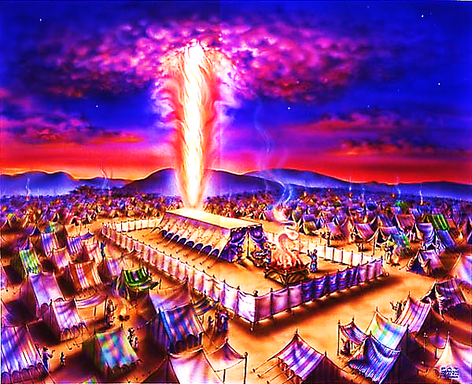
The Tabernacle in the Wilderness pt. 8

Slide 2
Note: Any videos in this presentation will only play online. After you download the slideshow, you will need to also download the videos from YouTube & add them back into your PowerPoint.
We present these messages at Bee Creek Park in College Station, TX. If you would like to watch the video of the service with this message, click here:
http://campaignkerusso.org/?p=10142
We would love to know more about the people who download our lessons & sermons. We invite you to email us & let us know where & how you use them.
info@ckbrazos.org

Slide 3
The bible is is the story of God trying to make a way to live with men.

Slide 4
Everything About the Tabernacle Points to Jesus

Slide 5
It was a tent, made of mere fabric, yet it was full of the glory of God!

Slide 6
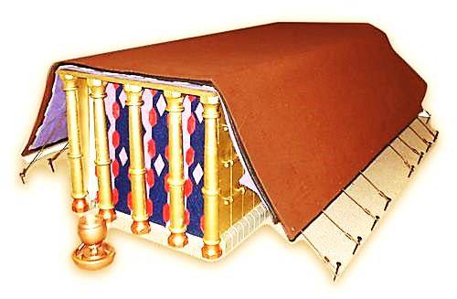
The Tabernacle was built using very expensive materials such as gold, silver, bronze, and special cloth.

Slide 7
The gold in the Tabernacle weighed over a ton. Today, the cost would be more than a million.
This reminds us of Jesus -- The greatest treasure in the universe!

Slide 8
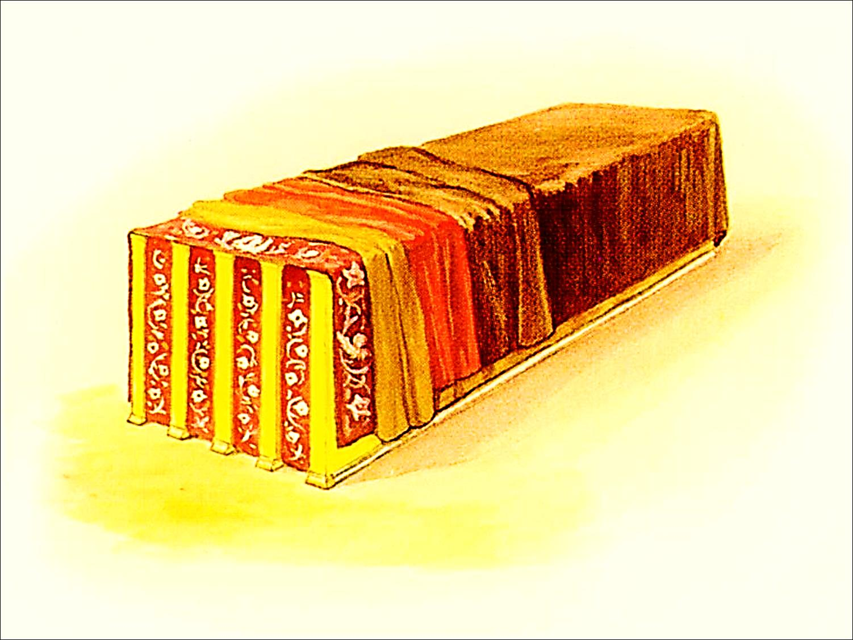
Then, they put four coverings over it.

Slide 9
We looked at the first covering – the one nearest to the glorious presence of God inside the tent. We learned that it’s four colors remind us of our Divine Lord Jesus!

Slide 10
The WHITE threads remind us of the sinlessness and purity of Jesus.
“And you know that Jesus came to take away our sins, for there is no sin in him.”
1 Jn. 3:5

Slide 11
The RED threads remind us of our suffering Savior and His BLOOD shed as the price of our salvation:

Slide 12
PURPLE was the color worn by kings. The soldiers used a purple robe to make fun of Jesus for Calling Himself a King.

Slide 13
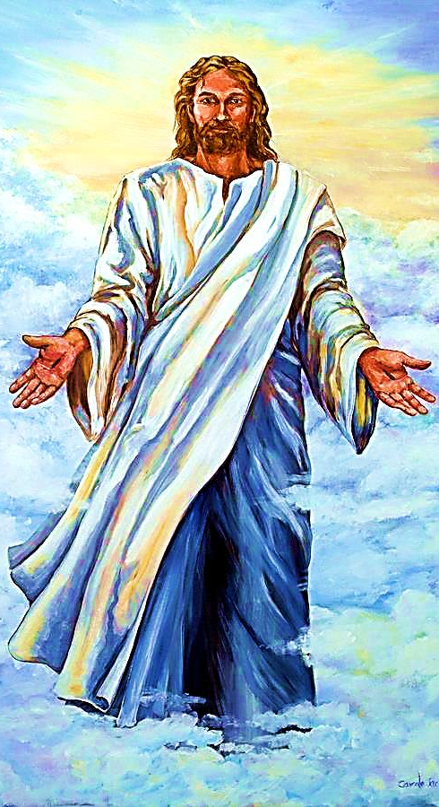
“And on his robe and on his leg is a name, KING OF KINGS, AND LORD OF LORDS.” Rev. 19:16

Slide 14
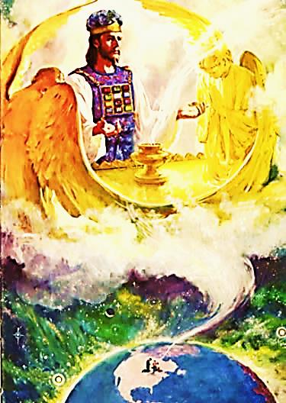
BLUE is the color of the heavens. The Hebrews tent was beautiful, but it was just a copy of the true tabernacle in Heaven.

Slide 15
Also, it is covered with angels. This reminds us of the guarding angel that God placed outside of the Garden of Eden to prevent Adam & Eve from entering.
It also reminds us of how angels surround the Lord Jesus in Heaven & worship Him continually – crying Holy! Holy! Holy!

Slide 16
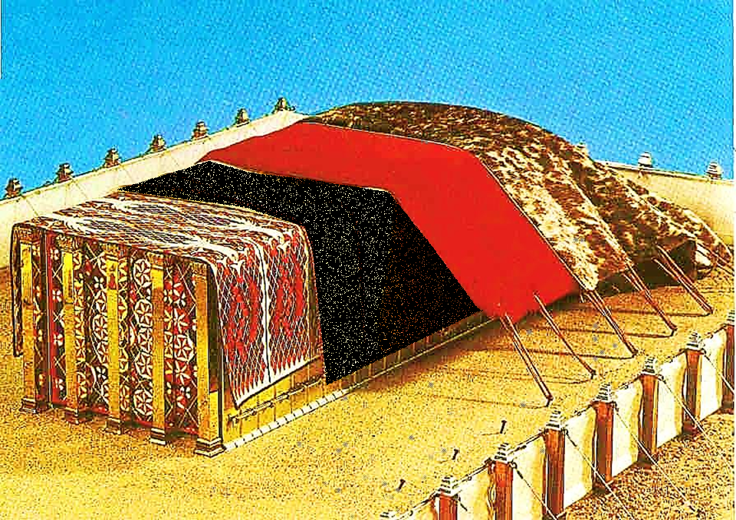
Today, we will look at the next covering.
Our Divine
Christ

Slide 17
The Woven Goat Hair
The goat hair covering is all about man’s sin & failure.
It was common practice for the tent dwellers of that time to make their tents out of black woven goat hair. This cover may have been black…

Slide 18
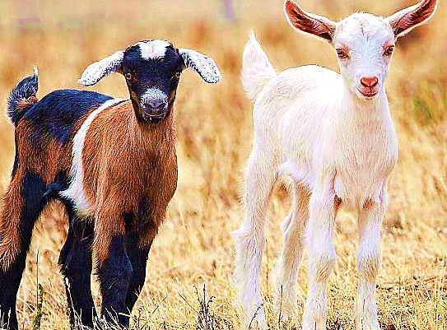
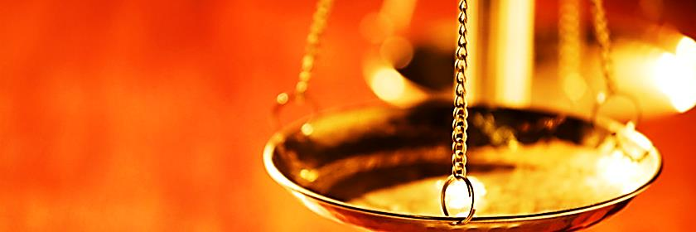
However, the goat hair could have been any color.
(The bible doesn’t say)
There is no such thing as “gray areas” or “little white lies.”
All sin weighs the same to God → Black, Gray & White

Slide 19
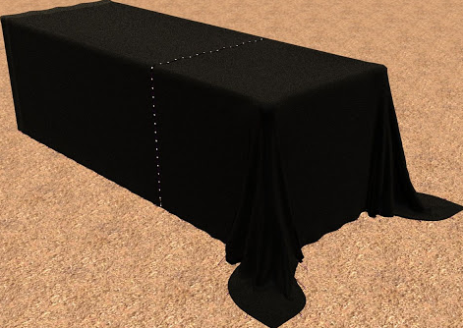
We know that this covering completely covered the beautiful covering beneath it.
This is a picture of the Lord Jesus taking our sin upon Himself.
Man’s Sin & Failure
“Christ never sinned but God put our sin on Him...” 2 Cor. 5:21
On the cross, Jesus was covered with our sin
.

Slide 20
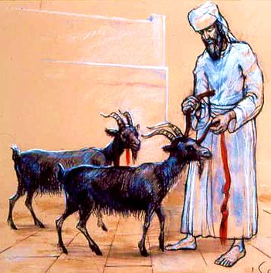
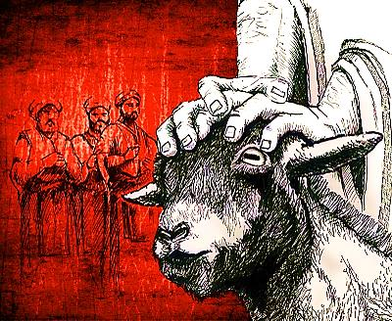
The ‘SCAPEGOAT’ was an innocent goat that the High Priest laid hands upon & confessed the nation’s sins. It was then sent out of the camp.
The ‘SIN OFFERING’ was an innocent goat that died for one year’s worth of the nation’s sins.

Slide 21
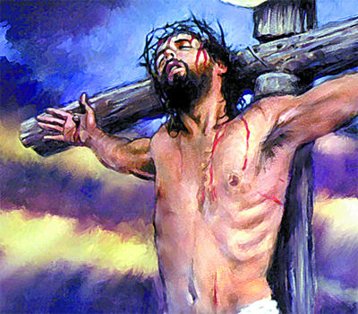
“…sending His own Son in flesh like ours… as a sin offering” Rom. 8:3
Jesus is Our Sin Offering Who
Died for Our Sins – not just for one year, but Forever!
Jesus is Our SCAPEGOAT
“He has removed our sins as far from us as the east is from the west.” Psalm 103:12

Slide 22
Next, we will look at the next covering.
Our Sin Offering
Our Divine
Christ

Slide 23
What is the Sinner‘s Prayer?
This is a prayer we can pray when we are ready to admit we are sinners and need Christ’s forgiveness.
It must be prayed with faith in our hearts and a readiness to have a life-changing encounter with Jesus Christ.

Slide 25
John Wesley’s Testimony
“…the preacher was describing the change which God works in the heart through faith in Christ and I felt my heart strangely warmed.”
Disciple’s Testimony
“They said to each other, ‘Did not our hearts burn within us while he talked to us on the road, while he opened to us the Scriptures?’”

Slide 26
A prayer of faith → Pray this prayer if :
If you never have before
You have in the past, but you think it would mean more today
You have been walking afar off and you want to come back
You want to set an example & show others how it is done
You just like to give your heart to Jesus again & again
Faith

Slide 27
We Declare Our Faith Publicly Because Jesus Declared His LOVE Publicly
“If you stand before others and are willing to say you believe in me, then I will tell my Father in heaven that you belong to me.” Mat 10:32

Slide 28
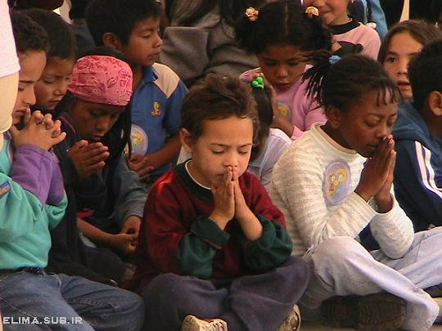
Dear Jesus,
I know I am a sinner & need your forgiveness.
I believe you died for my sins.
I now turn from sin.
Come into my heart I pray.
Do you want to meet Jesus as your savior right now?
Do you believe He died to save you from your sins & that He rose from the dead?
Do you believe that He is waiting to save you right now?

Slide 29
“But some people did accept him. They believed in him, and he gave them the right to become children of God.” John 1:12

Slide 31
“If you openly say, ‘Jesus is Lord’ and believe in your heart that God raised him from death, you will be saved.”
Rom. 10:9
What did you learn today?
What is the meaning of the name-tag?
What have you neen thinking about God lately?
What do you want to tell the world about Jesus?

Slide 32
“Draw near to God, and He will draw near to you…
…Cleanse your hands, you sinners, and make your hearts pure, you who are half-hearted towards God.” James 4:8 WNT

Slide 33
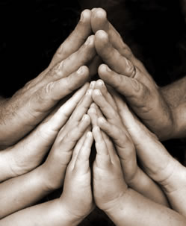
Close in Prayer

Slide 34
Note: Any videos in this presentation will only play online. After you download the slideshow, you will need to also download the videos from YouTube & add them back into your PowerPoint.
We present these messages at Bee Creek Park in College Station, TX. If you would like to watch the video of the service with this message, click here:
http://campaignkerusso.org/?p=10142
We would love to know more about the people who download our lessons & sermons. We invite you to email us & let us know where & how you use them.
info@ckbrazos.org

Slide 35
Welcome to Aggieland Faith Family Style Worship

Slide 36
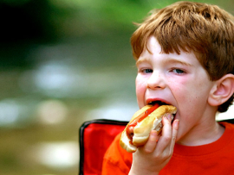
CURRENT SCHEDULE: See www.Aggielandfaith.org
SATURDAY —
At Bee Creek Park
2:00-4:00pm: Through the bible with felt-board stories – plus hot-dogs & drinks
SUNDAY —
At Bee Creek Park
2:00-4pm: Free snacks, drinks, kids crafts, prizes, singing & bible preaching

Slide 37
Would You Like Prayer or Bible Study at Your House?
Personal Prayer: We can come to your home & pray with you, or you can email us when you need prayer.
Home Bible Study: We will come to your home & hold a bible study for you & your friends.
Bible Party: We will hold a Kid’s Bible Party: You provide the food & kids - we will do the bible fun & stories.

Slide 38
Would You Like Visitation?
We will visit a friend, loved one in the hospital or in prison to pray for them & share Christ with them.
Contact: info@aggielandfaith.org

Slide 39
www.aggielandfaith.org
Go here to see pictures & videos
Go here to subscribe to e-mails about changes & cancellations

Slide 40
Note: Any videos in this presentation will only play online. After you download the slideshow, you will need to also download the videos from YouTube & add them back into your PowerPoint.
We present these messages at Bee Creek Park in College Station, TX. If you would like to watch the video of the service with this message, click here:
http://campaignkerusso.org/?p=10142
We would love to know more about the people who download our lessons & sermons. We invite you to email us & let us know where & how you use them.
info@ckbrazos.org

